Slide 1
Geolocation based Applications
1205 Sang-Kwon Park 1415 Jun-Min Jin 1610 Si-Yoon Yoo

Slide 2
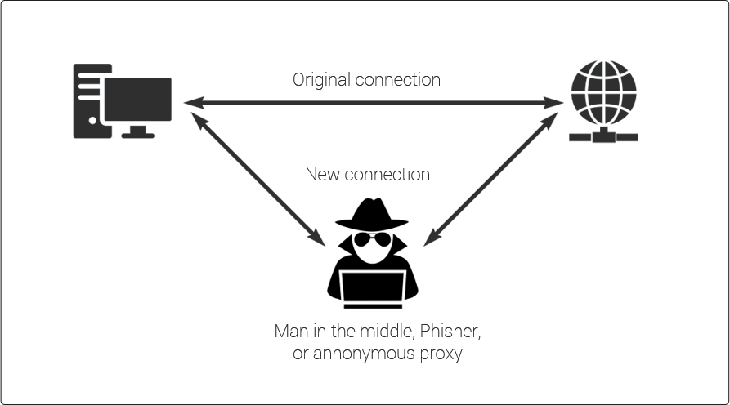
Man in the middle attack

Slide 3
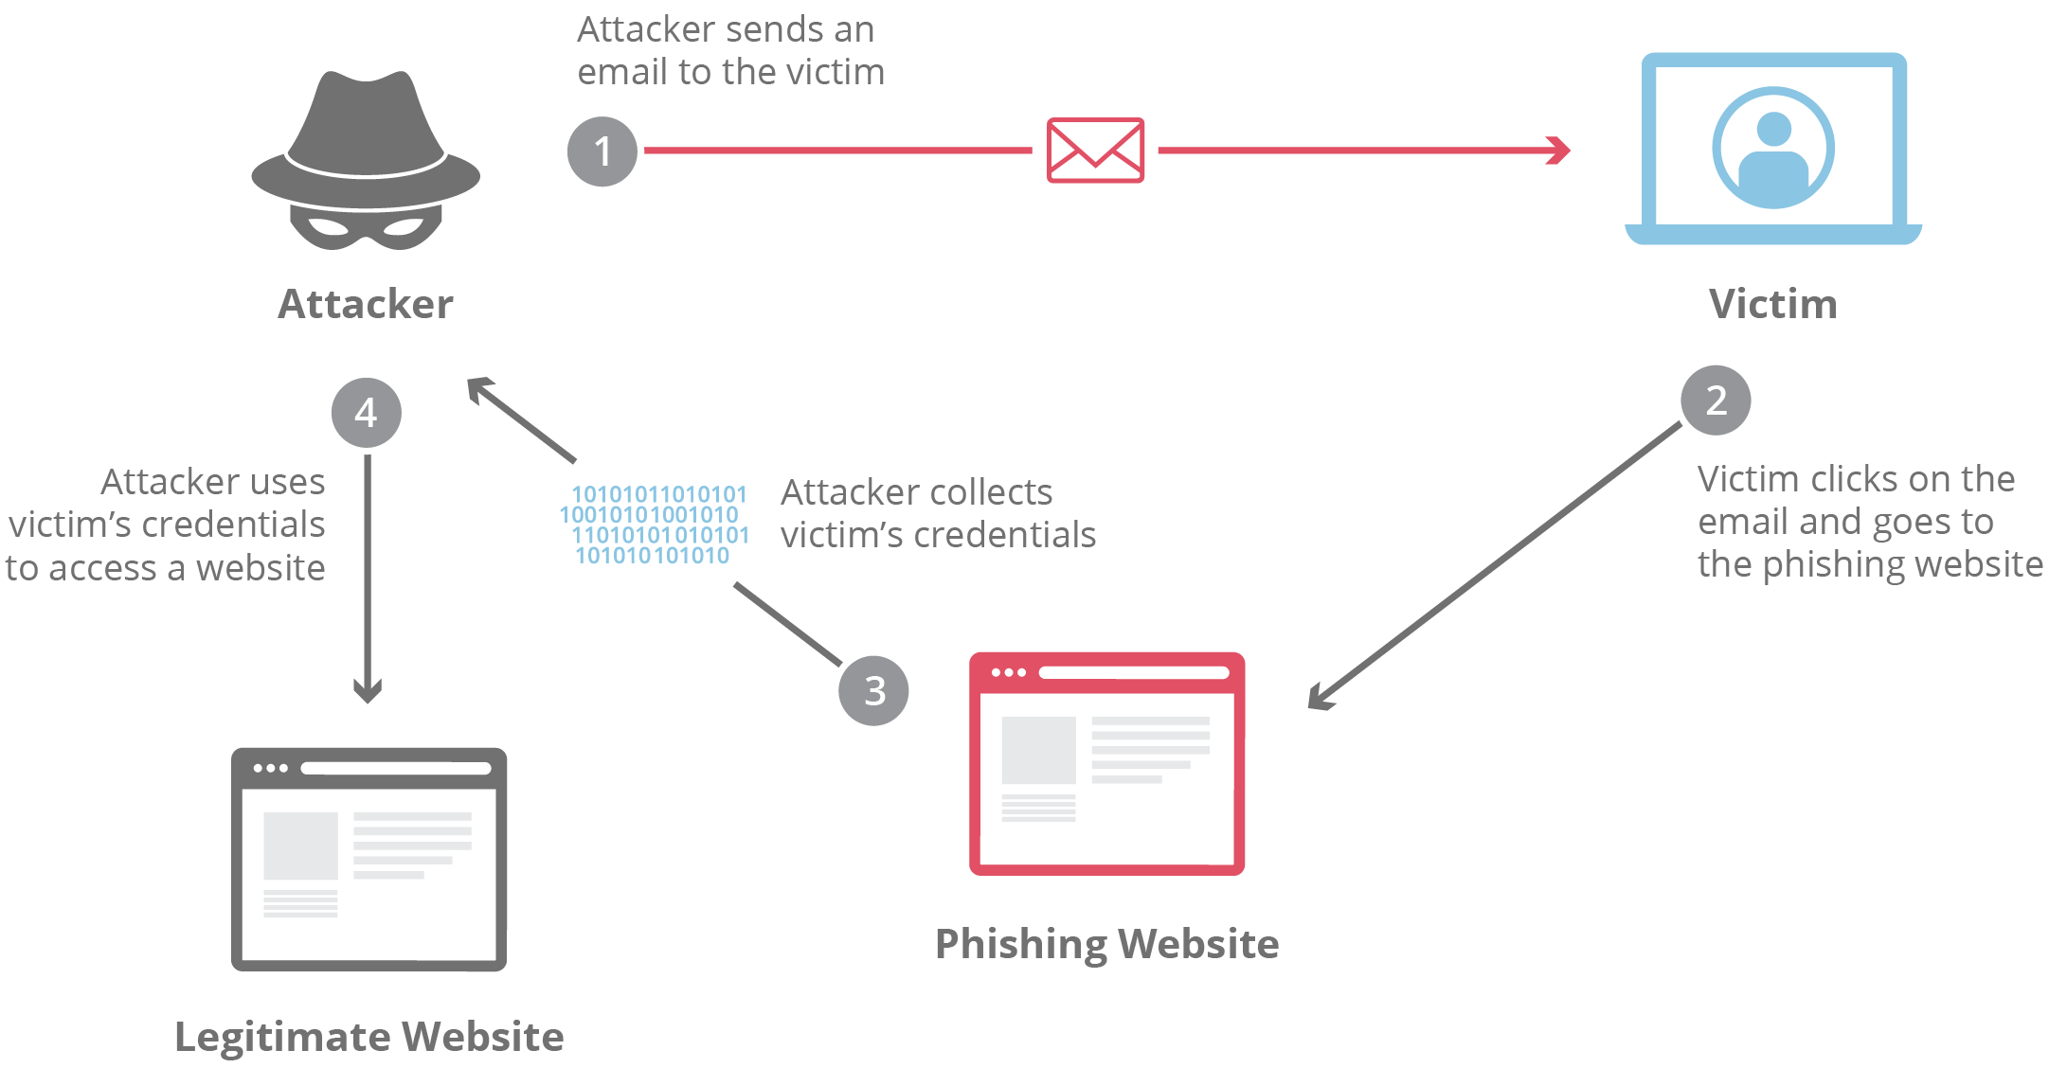
Phishing Attack

Slide 4
Then, How could we detect or prevent attacks ?

Slide 5
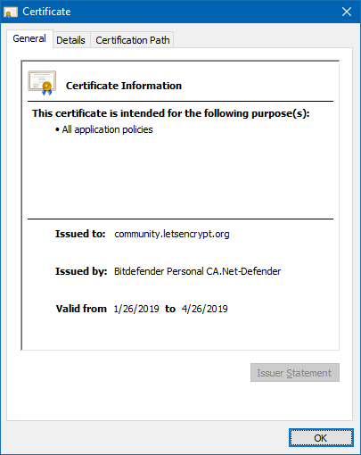
Detection of MITM
Notes:
IP address location data can include information such as country, region, city, postal/zip code,^{[6]} latitude, longitude and time zone.^{[7]} Deeper data sets can determine other parameters such as domain name, connection speed, ISP, language, proxies, company name, US DMA/MSA, NAICS codes, and home/business.

Slide 6
Prevention of MITM
Tectia SSH and SSL/TLS
OpenSSH
SSH
IPSec with preshared keys
Notes:
IP address location data can include information such as country, region, city, postal/zip code,^{[6]} latitude, longitude and time zone.^{[7]} Deeper data sets can determine other parameters such as domain name, connection speed, ISP, language, proxies, company name, US DMA/MSA, NAICS codes, and home/business.

